Slide 1


Can You Even Debug a 200M+ Gate Design?
Horace Chan
PMC-Sierra
Brian Vandegriend
PMC-Sierra
Deepali Joshi
PMC-Sierra
Corey Goss
Cadence

Slide 2
Overview:
Debug techniques for a 200M+ gate design
Testbench built in Specman UVMe
Simulator: Cadence IES
Speed up debug turnaround time for RTL
saving and Loading Checkpoint Snapshots
dynamic Load Additional Code at Saved Checkpoints
waveform Verbosity
Speed up debug turnaround time for testbench/software
incremental compile of the Specman testbench
software/Hardware co-verification

Slide 3
Saving and Loading Checkpoint Snapshots
Problem:
Long simulation time
Need to wait a long time to reproduce the failure
Probing waveform slow down the simulation even more
Solution:
Save a checkpoint snapshot every 30 minutes
Save a checkpoint snapshot every 1ms of run time
Save a checkpoint after each key testflow phase
Rerun from the save checkpoint to reproduce the failure

Slide 4
Saving and Loading Checkpoint Snapshots (Implementation)
Checkpoint period controlled by
Environment variables
Shell script arguments
vManager VSIF attributes
e constrains
Optimal checkpoint period depends on the snapshot size and the load of the network
E.g. 30 seconds checkpoint saving overhead for a 4G snapshot during work hours

Slide 5
Dynamic Load Additional Code at Saved Checkpoints
Unique feature of Specman and the e language
Can load additional e code after loading a snapshot to:
Change the constraint of a sequence
Modify the behavior of existing methods
Add and launch new sequence
The testbench is built with empty method hooks between each key testflow phase for dynamic load extension

Slide 6
Dynamic Load Additional Code at Saved Checkpoints (use case)
Add extra debug code to print more information
Change the sequence stimulus generation around the failure point to explore the bug
Test different what-if scenarios without waiting for the simulation to run from time zero
Skip the 3 hours wait to configure the device and wait for the traffic to stabilize
Group regression runs that share a common initial period to reduce CPU and license usage

Slide 7
Waveform Verbosity
Same idea as message verbosity
The less waveform probed, the faster the simulation
The more waveform probed, the more debug info
Easy control to set the waveform verbosity at run time
Suggested verbosity level
NONE: No waveform is probed
LOW: Probe all the ports of the module
MEDIUM: Probe all the internal signals of the module
HIGH: Probe the memories and variables of the module
FULL: Probe delta cycle changes of the signals

Slide 8
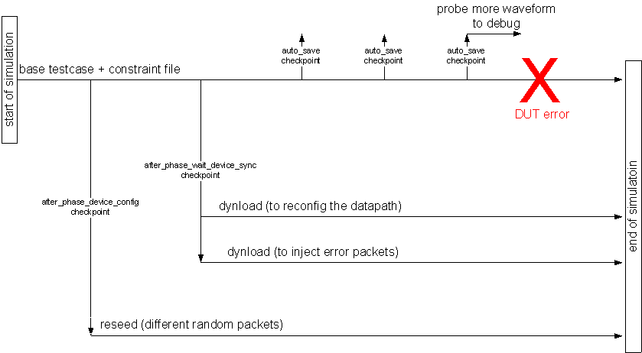
Checkpoint Usage Example

Slide 9
Incremental compile of the e testbench
Compiled testbench runs 3x faster
Interpreted testbench has better debug support
Can reload the testbench without exiting the simulator
Keep the CPU and license
Can keep the current state of the simulation without rewinding back time zero
Loading initial snapshot takes a long time
The best of both worlds:
Can compile stable testbench code for optimal performance
Code still under development can be run in interpreted mode for optimal debug

Slide 10
Software/Hardware co-verification
Integrate software (C code) with the testbench (e code)
The C code is running on the Linux host as a thread inside the simulator
1000x faster than running inside the CPU RTL
100x faster than running with CPU model
Replay the software calls without the simulator
Reduce software debug turnaround time from 30 minutes to 30 seconds
SimVision GUI has source debugger for all languages in the testbench and DUT. (e, C, Verilog/VHDL/SV)
Implementation details refer to:
Hardware/Software Co-Verification Using Specman and SystemC with TLM Ports, DVCON2011

Slide 11
Benefits and results
Speed up the RTL debug turnaround time by 90%
Average time to failure in simulation is 6 hours
Reduce overall development time by 50%
The compiled testbench is running 300% faster
Specman CPU usage: 15% down to 5%
Silicon bring up in the lab with already tested software
From 2-3 weeks down to 1-2 days

Slide 12
Future development
Port to SystemVerilog and other simulators
Saving and Loading Checkpoint Snapshots
Easy to port. If the simulator supports saving checkpoint.
Dynamic Load Additional Code at Saved Checkpoints
Impossible to port. Unique feature in Specman
Waveform Verbosity
Easy to port. The code is implemented in tcl
Incremental compile of the Specman testbench
Hard to port. Unless SV supports AOP
Software/Hardware co-verification
Easy to port. SV supports DPI-C programming interface too.

